Slide 1
Welcome to Our Presentation!

Slide 2

Team Gama
Naznin Nahar Akhi (ID: 17183103001)
Farhana hossain (ID: 17183103033)
Fatema Tuz Zohra (ID: 17183103009)
Syeda Nowshin Ibnat (ID: 17183103020)
Fehenna Khairatun Hisan (ID: 17183103026)
Mahmuda Begum (ID: 17183103030)
Nawrin Zaman Prova (ID: 17183103044)
Nusrat Jahan Anka (ID: 17183103008)
Shamrima Eye Noon Huda (ID: 17183103006)
Nazmon Nahar Khanam Putul (ID: 17183103019)
Intake- 39(section-1)
Dept. of Computer Science and Engineering

Slide 3
TABLE OF CONTENTS
01
03
02
04
Operators
Introducing Class
Control Statements
Conclusion

Slide 4

INTRODUCTION
Java is a class-based, object-oriented programming language.
Java was originally developed by James Gosling and released in 1995.
The latest versions are Java 14, released in March 2020, and Java 11, a currently supported long-term support (LTS) version, released on September 25, 2018.

Slide 5
– Chris Heilmann
“Java is to JavaScript what car is to Carpet.”

Slide 6
01
Operators

Slide 7
ABOUT THIS TOPIC
Operator in Java is a symbol which is used to perform operations. For example: +, -, *, / etc.

Slide 8
Types of operators in Java
Unary Operator
Arithmetic Operator
Assignment
Relational Operator
Bitwise Operator
Logical Operator
Postfix: x++,x--
Prefix: ++x,--x
Assigns a value to a variable.
Ex: +=, -=, *=, %=,/=
+,-,x,/,%
Comparison: < > <= >= instanceof
Equality: == !=
Bitwise AND: &
Bitwise exclusive OR: ^
Bitwise inclusive OR: |
Logical AND: &&
Logical OR: ||
Logical NOT: !

Slide 9
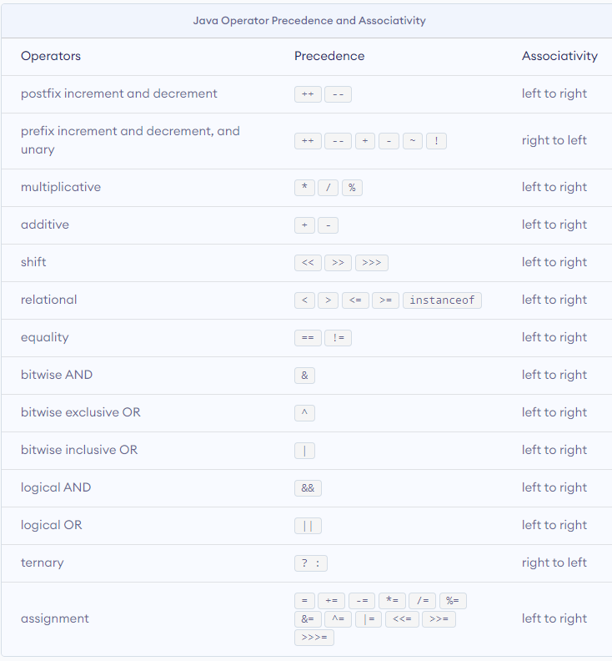
Operator Precedence

Slide 10
Example
package JavaOperators;
public class Operators {
public static void main(String[] args)
{
int a = 20, b = 10, c = 0, d = 20, e = 40, f = 30;
// Arithmetic Operator: + and / operator
System.out.println("a + b = " + (a + b));
//Unary Operators:
// pre-increment or prefix operator , a = a+1 and then c = a;
c = ++a;
System.out.println("Value of c (++a) = " + c);
// Assignment operators
// shorthand assignment operator
a += 1;
b -= 1;
System.out.println("a, b(" + "using shorthand operators)= " + a + ", " + b );
// Relational operators
System.out.println("a <= b :" + (a <= b));
int x = 0x0005;
int y = 0x0007;
// bitwise and
// 0101 & 0111=0101
System.out.println("x&y = " + (x & y));
}

Slide 11
02
Control Statements

Slide 12
ABOUT THIS TOPIC
A control statement in Java is a statement That determines whether the other statements will be executed or not. It controls the flow of a program.

Slide 13
condition using if/else in java
Use if to specify a block to be executed, if a specified condition is true.
Use else to specify a block of code to be executed, if the same condition is false.
Use else if to specify a new condition to test, if the first condition is false.

Slide 14
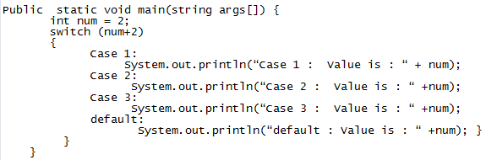
Example of switch case

Slide 15
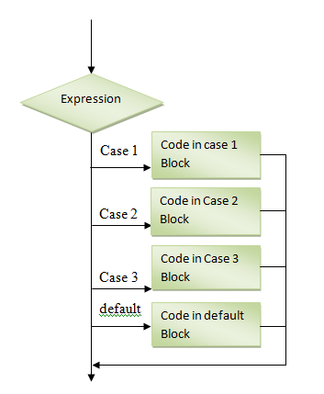
Switch Case Flow Diagram

Slide 16

For Statement

Slide 17
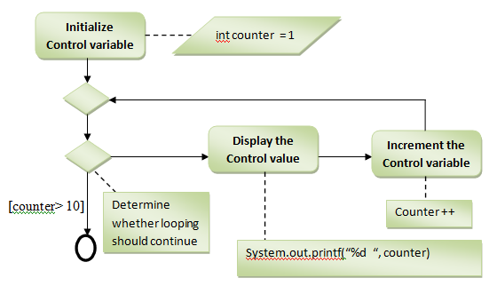
UML activity diagram for the for statement

Slide 18
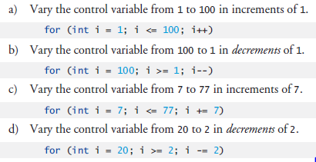
Examples Using the for Statement

Slide 19
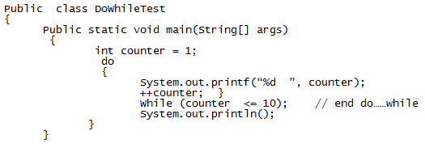
Do...while Repetition Statement

Slide 20
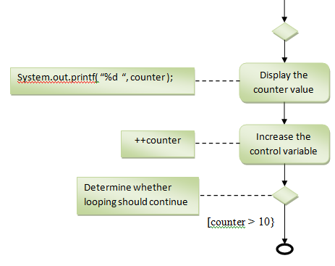
UML activity diagram do..while repetition statement

Slide 21
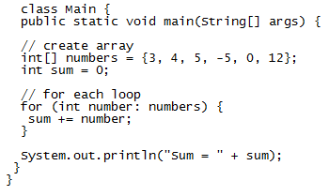
Examples of for-each loop

Slide 22
03
Introducing Class

Slide 23
ABOUT THIS TOPIC
The class is at the core of Java. It is the logical construct upon which the entire Java language
is built because it defines the shape and nature of an object.

Slide 24
Table of contents
1.Naming Convention
4.Garbage Collection
2.Constructor
3.this keyword
5.Finalized() method

Slide 25
Naming Conventions in Java
There are some naming conventions of java programming language. They must be followed while developing software in java for good maintenance and readability of code. Java uses methods, variables, classes, packages and constants.

Slide 26
Methods :
A method is a block of code which only runs when it is called. We can pass data (known as parameters) into a method. Methods are used to perform certain actions and they are also known as functions.
Example:
This is the general form of a method:
type name(parameter-list) {
// body of method
}

Slide 27
Variables :
A variable is a container which holds the value while the Java program is executed. A variable is assigned with a data type.
Variable is a name of memory location. There are three types of variables in java: local, instance and static.
Example:
// variables for Bike class
int speed = 0;
int gear = 1;

Slide 28
Classes :
A class is a user defined blueprint or prototype from which objects are created. It represents the set of properties or methods that are common to all objects of one type.
Example :
class Box {
double width;
double height;
}

Slide 29
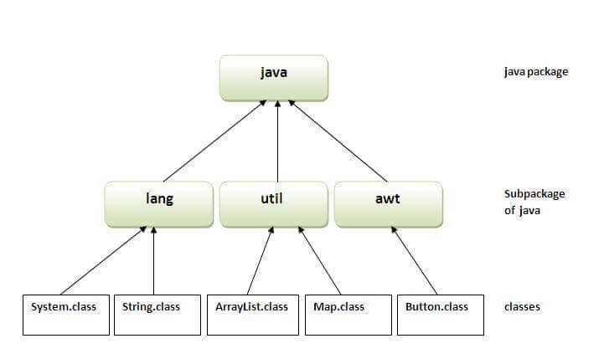
Packages :
A java package is a group of similar types of classes, interfaces and sub-packages. Package in java can be categorized in two form, built-in package and user-defined package.

Slide 30
Constructor
In Java, a constructor is a block of codes similar to the method. It is called when an instance of the class is created. At the time of calling constructor, memory for the object is allocated in the memory.
Example :
// This is the constructor for Box.
Box() {
System.out.println("Constructing Box");
}
Box(int x, int y){
x= height;
y= width;
}

Slide 31
this keyword
The this keyword refers to the current object in a method or constructor. The most common use of the this keyword is to eliminate the confusion between class attributes and parameters with the same name.
Example :
Box(double w, double h, double d) {
this.width = w;
this.height = h;
this.depth = d;
}

Slide 32
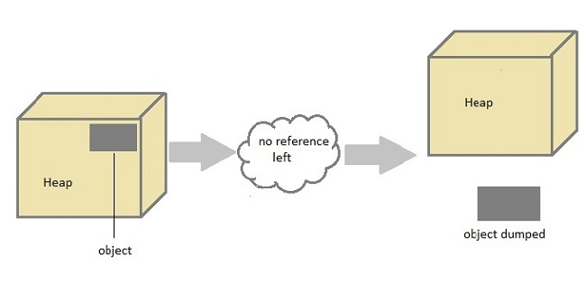
Garbage Collection
Java garbage collection is the process by which Java programs perform automatic memory management. Eventually, some objects will no longer be needed. The garbage collector finds these unused objects and deletes them to free up memory.

Slide 33
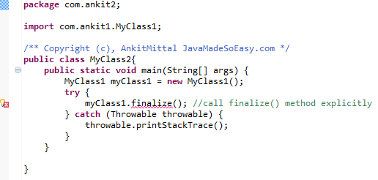
The finalize( ) Method
The java. lang. Object. finalize() is called by the garbage collector on an object when garbage collection determines that there are no more references to the object. A subclass overrides the finalize method to dispose of system resources or to perform other cleanup.

Slide 34
RESOURCES
Book: The Complete Reference by Herbert Schildt
Websites:
Javatpoint → https://www.javatpoint.com/
GeeksforGeeks → https://www.geeksforgeeks.org/

Slide 35
THANKS!
Do you have any questions?

